Slide 1
Cressman K/Cl/Na model

Slide 2
Summary
Published
[Cressman et al, 2009 I & II] – single neuron and network model (persistent activity) based on dynamic ionic concentration
Single compartment neuron with dynamic ion concentrations for Na, K, Cl, glial K buffering and diffusion

Slide 3
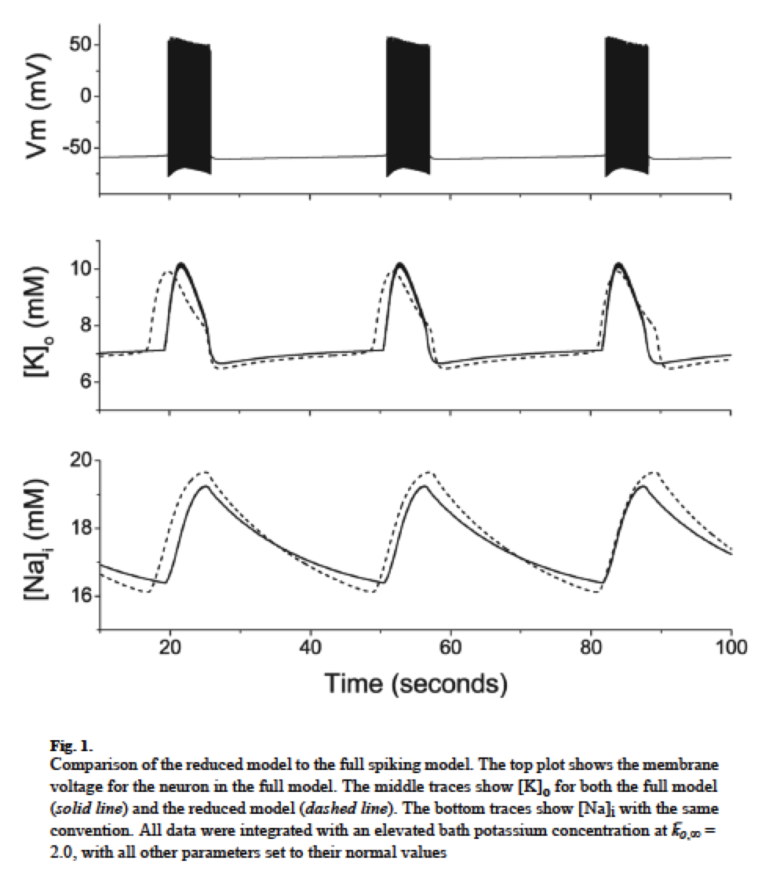
Model dynamics

Slide 4
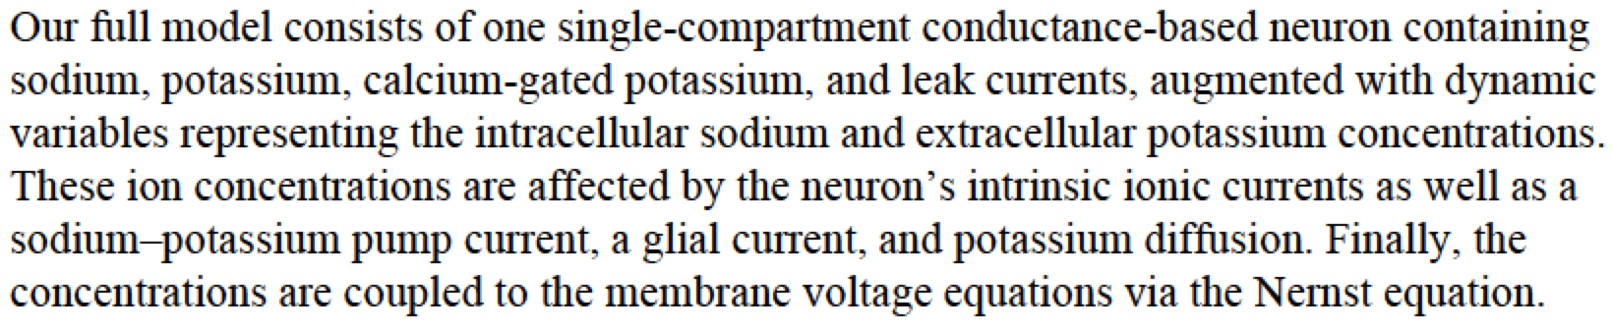
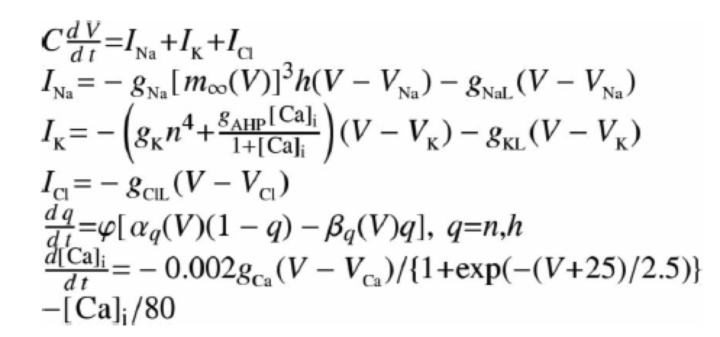
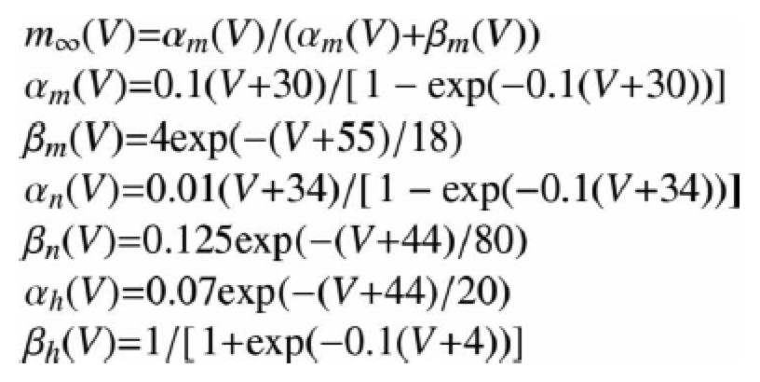
Membrane potential

Slide 5
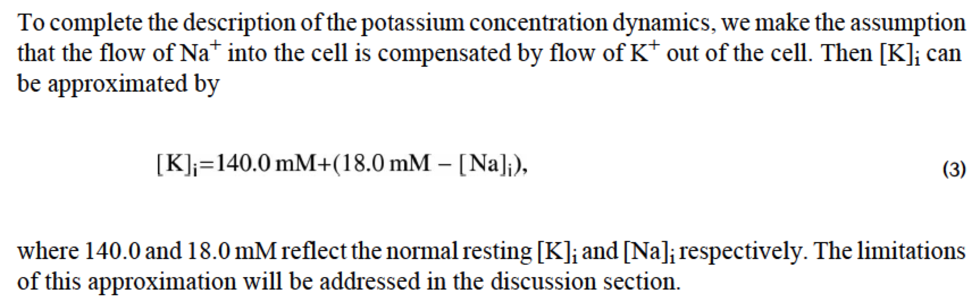
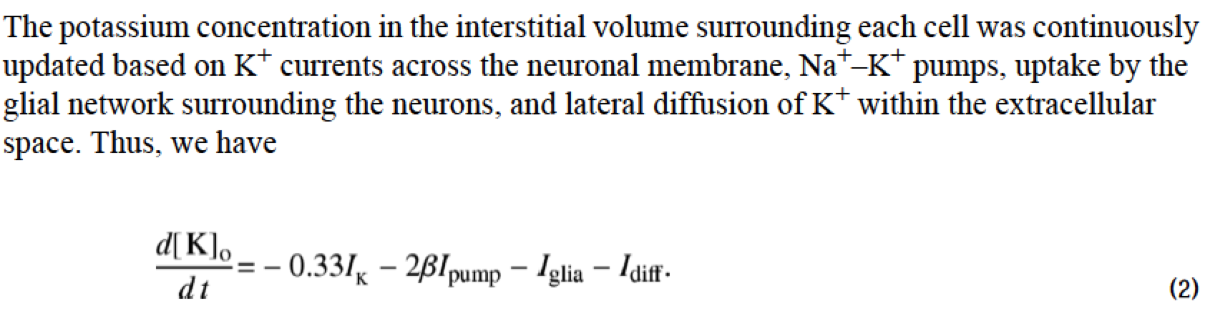
Intra/Extra K concentration

Slide 6
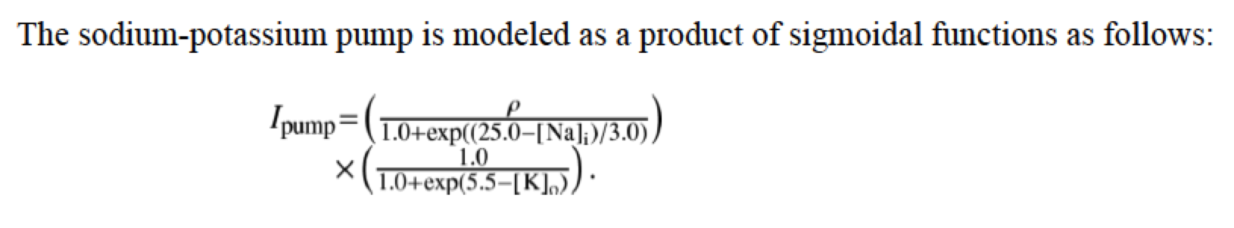
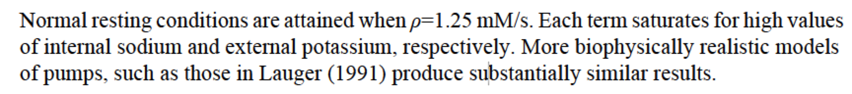
Na-K pump

Slide 7
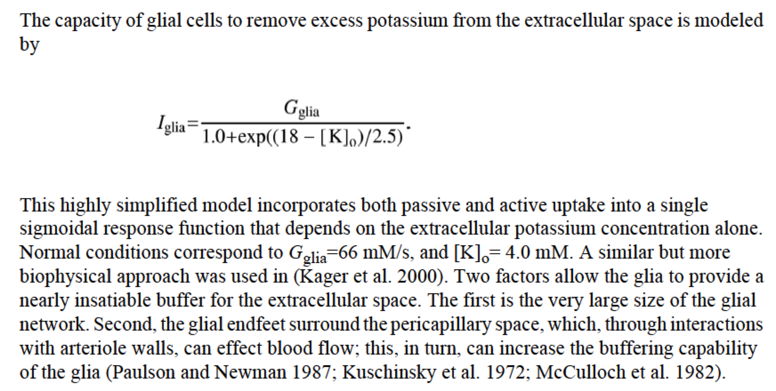
Glial buffer

Slide 8
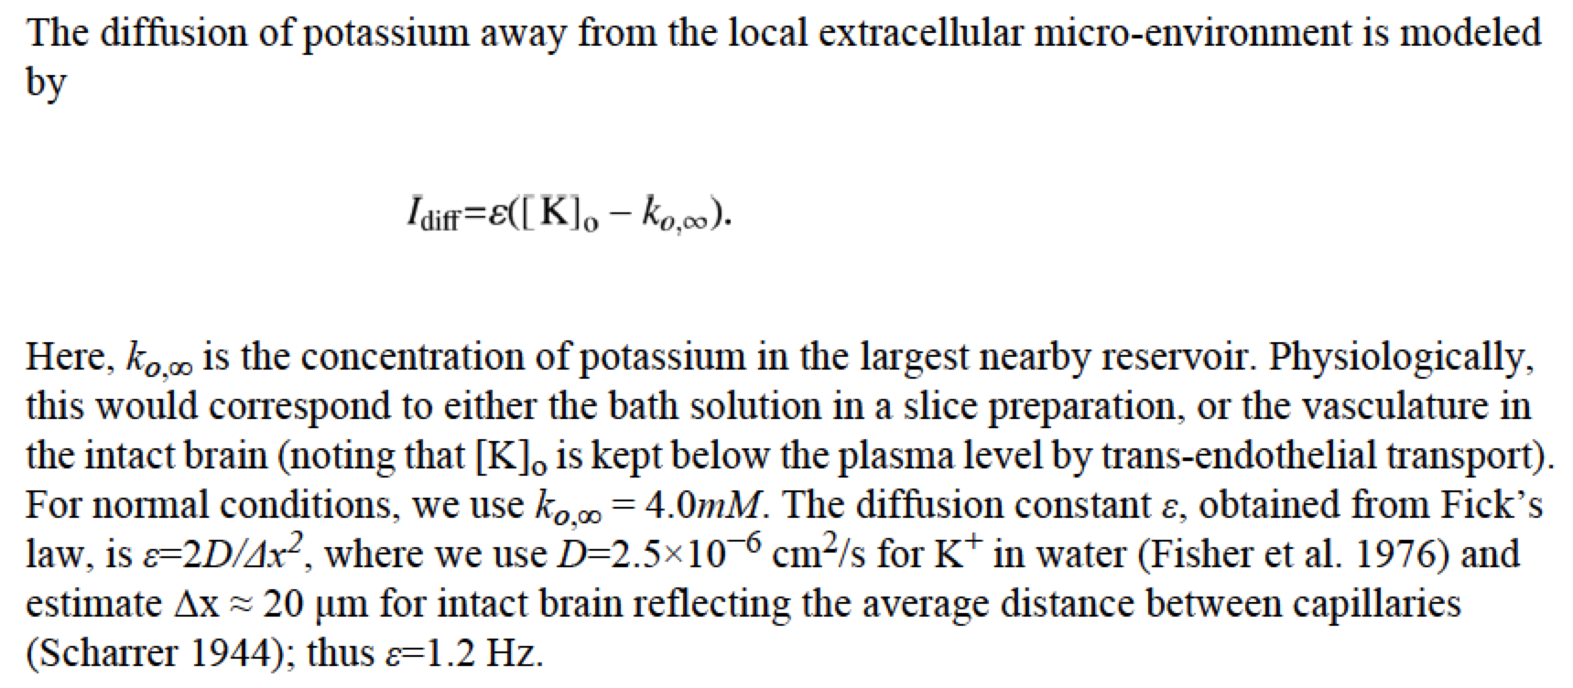
Extracellular K diffusion

Slide 9
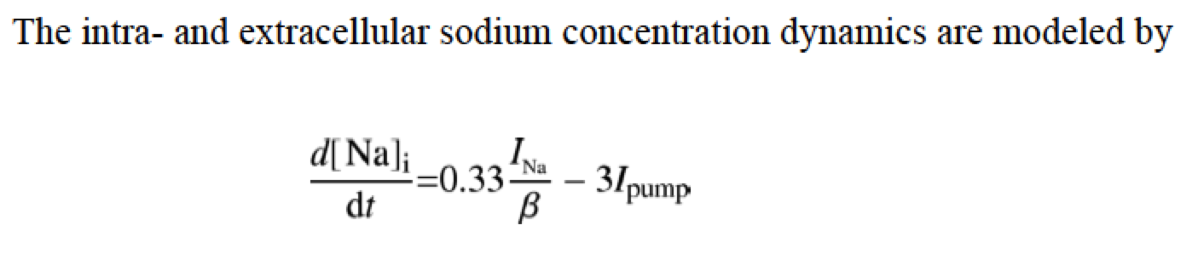
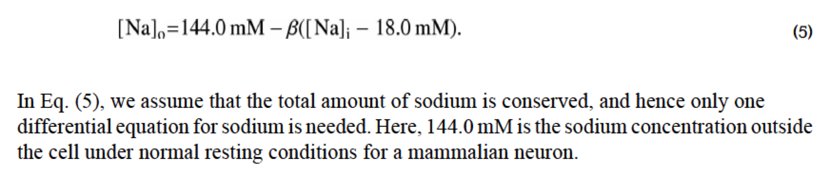
Intra/Extra Na concentration

Slide 10
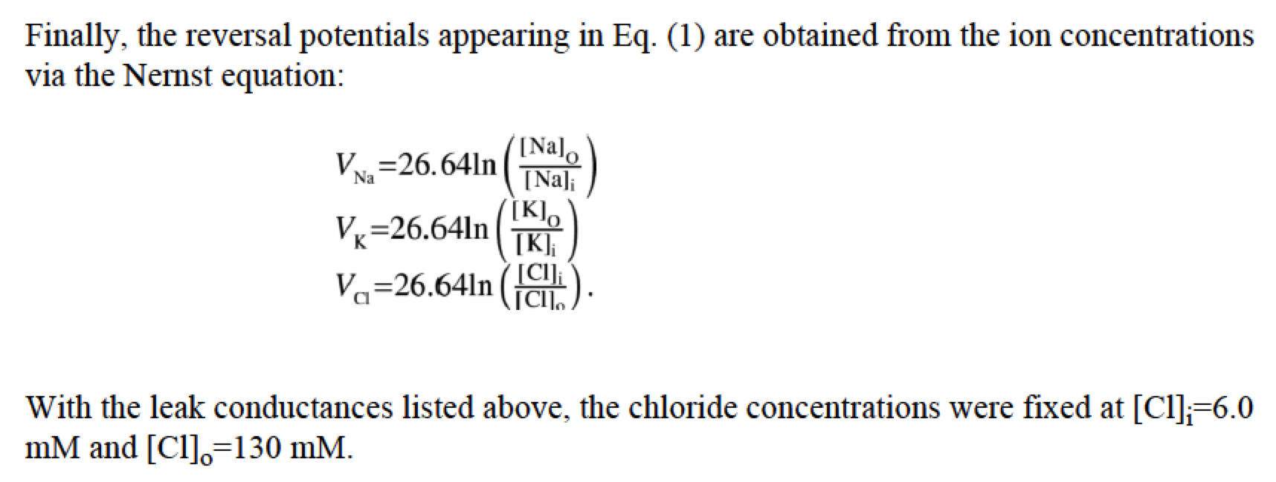
Reversal potentials

